Slide 1
How to Judge Others
Matthew 7:1-6
Dr. Rick Griffith, Crossroads International Church Singapore
BibleStudyDownloads.org

Slide 2
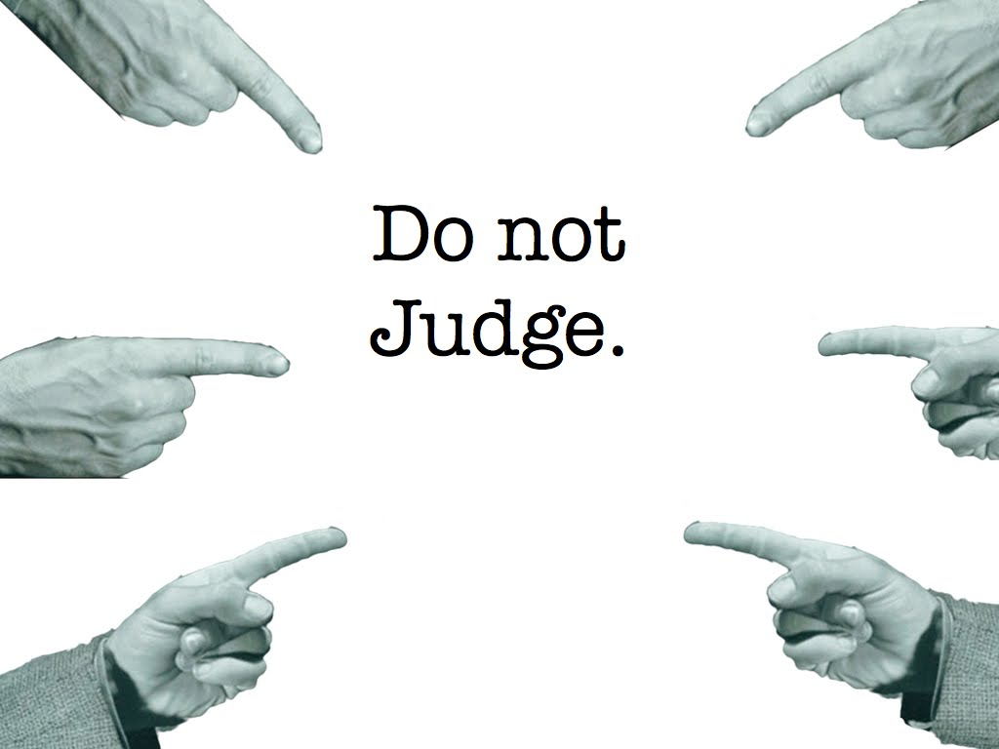
Do not judge.
Notes:
People today claim we shouldn't judge others.
But isn't that making a judgment?

Slide 3
Don't Judge, Just Love
Notes:
When others proclaim that we shouldn't judge people, aren't they judging how we judge?
Perhaps the issue isn't whether we judge, but how we judge.
At least that is what my own judgment says! (By the way, did you notice "don't" is missing the apostrophe?)

Slide 4
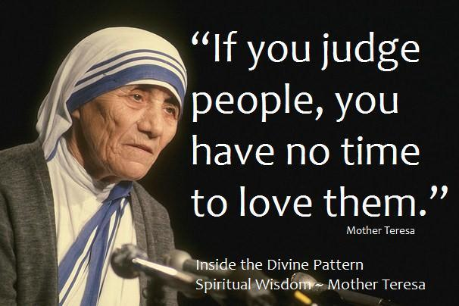
"If you judge people, you have no time to love them." —Mother Teresa
Notes:
You can turn on the radio or surf the net to get an earful of the world's judgment about judging. Even Mother Teresa said never to judge!

Slide 5
THE ULTIMATE JUDGE:
Notes:
But we have come here today to hear what God says about judging others. After all, he is the final Judge, right?

Slide 6
How should you judge others?
Notes:
What is the way God says to judge people—if we should do so!

Slide 7
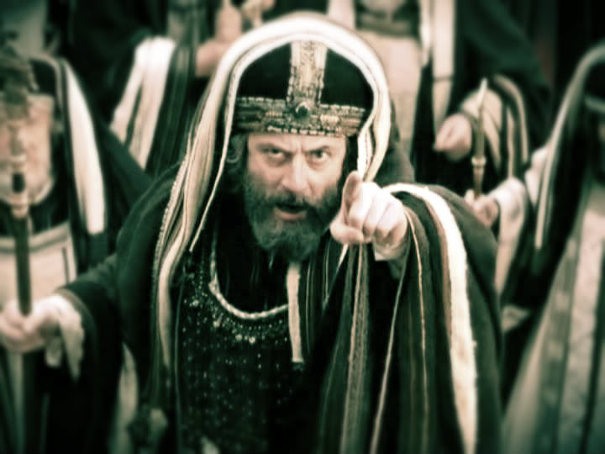
Pharisees
Notes:
The Pharisees excelled at judging people.

Slide 8
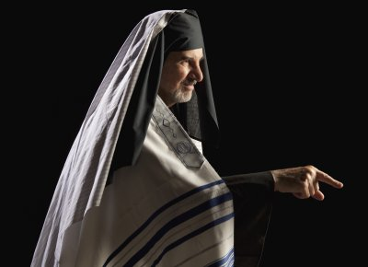
The Pharisee Sabbath
Walk
Scribe
Tailor
Ceremonial washing
Notes:
They judged how far a person could walk on Saturday.
They judged that a scribe could write only two letters on that day.
They judged that a tailor could not have a needle in his cloak on the Sabbath.
They judged whether people washed their hands according to the Jewish tradition.
They were expert judges!

Slide 9
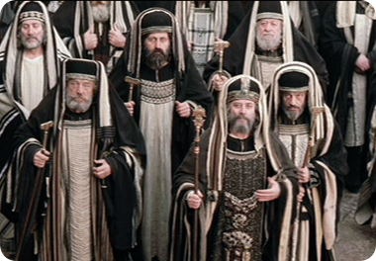
The Spiritual Police
Notes:
Like many of the other passages we've seen in this series, the Pharisees are prominently in the background even though they aren't even specifically mentioned in this passage.
These guys were the religious policemen similar to what we see in Saudi Arabia right now—making sure that others follow the Law when they weren't actually following it on their own!

Slide 10
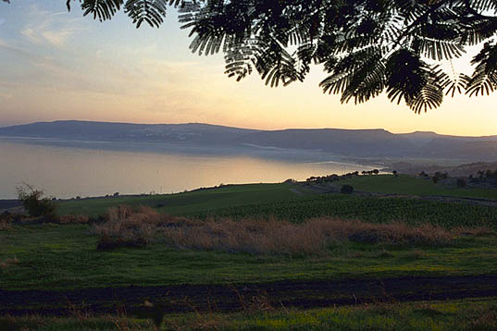
Mount of Beatitudes (Matthew 5–7)
Notes:
In the Sermon on the Mount, Jesus up to this point has done two major things

Slide 11
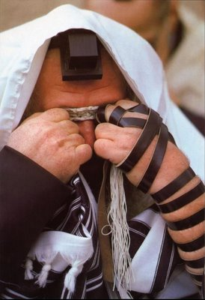
The Sermon on the Mount
Pharisee Teaching (Matthew 5)
Pharisee Practice (Matthew 6:1–7:6)
Notes:
In Matthew 5, Jesus first criticized the Pharisee teaching as merely external and thus missing the real intent of the Law, a law of the heart.
• Then, starting in chapter 6, he criticizes their teaching.

Slide 12
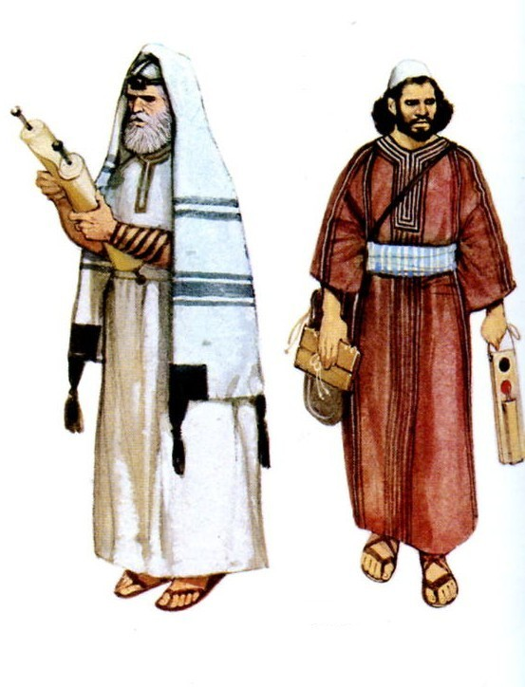
"For I tell you that unless your righteousness surpasses that of the Pharisees and the teachers of the law, you will certainly not enter the kingdom of heaven" (5:20 NIV).
Notes:
At the end of explaining the blessed life and his fulfillment of the Law (5:1-20), he introduced the next section in the rest of chapter 5 by declaring that we need to be more righteous than the Pharisees to be rewarded by God in the kingdom.

Slide 13
Back to Basics (Matt. 5:21-48)
"You have heard that it was said…"
6 Issues:
"But I tell you…"
Murder
Adultery
Divorce
Vows
Revenge
Enemies
God's True Intent
Pharisee Teaching
External purity won't enter the kingdom (20)
Notes:
In the end of Matthew we see how "Jesus rejected the traditions of the Pharisees (vv. 21-48) to get back to basics …
• Six times Jesus said, "You have heard that it was said. ...
• But I tell you" (5:21-22, 27-28, 31-32, 33-34, 38-39, 43-44).
• These words make it clear that Jesus was presenting (a) what the Pharisees and teachers of the Law were saying to the people and, by contrast,
• (b) what God's true intent of the Law was.
• This spelled out His statement (v. 20) that Pharisaic righteousness is not enough to gain entrance into the coming kingdom" (Barbieri, BKC, 2:30).
• They missed it on six issues: murder, adultery, divorce, vows, revenge, and enemies.

Slide 14
"Watch out! Don't do your good deeds publicly, to be admired by others…"
"for you will lose the reward from your Father in heaven" (6:1 NLT).
Notes:
Beginning in Matthew 6, he tells us that good deeds done only for others will be rewarded only with their admiration (7:1).

Slide 15
Rewards for Righteousness (Matt. 6:1–7:6)
Don't do this…
6 More Issues:
Do this instead…
Giving Prayer Fasting Investing Trust Judging
Pharisee Practice
Pure Practice
"Watch out! Don't do your good deeds publicly, to be admired by others, for you will lose the reward from your Father in heaven" (6:1 NLT)
Notes:
• In contrast to the hypocritical teaching of the Pharisees…
• Jesus gave his own humble teaching that was backed by his life example.
• In Matthew 7:1–7:6, Jesus addresses six areas of life: giving, prayer, fasting, investing, trust (not worry), and humility (not judging).
• Each of these areas shows that the religious leaders did their good works only for public show just like 7:1 warns against.

Slide 16
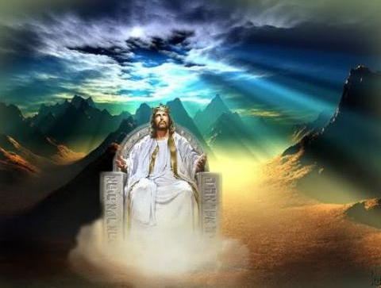
When Jesus is King… (Matthew 5–7)
What would your life look like if Christ was truly the boss of your life?
Notes:
All of these things support the main teaching of the Sermon that shows what life looks like when Jesus is King of our lives.

Slide 17
The Spiritual Police
Notes:
So the sixth area of Pharisee practice where they messed up was their judging—how they judged others but failed to judge themselves.
The call to "judge not" is thus a call to the humility needed in order for us to properly see others and properly see ourselves.

Slide 18
How should you judge others?
3 ways
Notes:
Today we'll see three qualities Jesus said we need when we judge people.

Slide 19
"But I thought we weren't supposed to judge?!"
Notes:
But, for some of you, your judgment says that we are not supposed to judge at all, so how can I be talking today about how to judge! Well, hold on and listen to what Jesus says.
In Matthew 7:1-6 he gives three ways to judge others

Slide 20
I. Judge with fear: Realize that God will judge you (7:1-2).
Notes:
The second way to judge others is to…

Slide 21
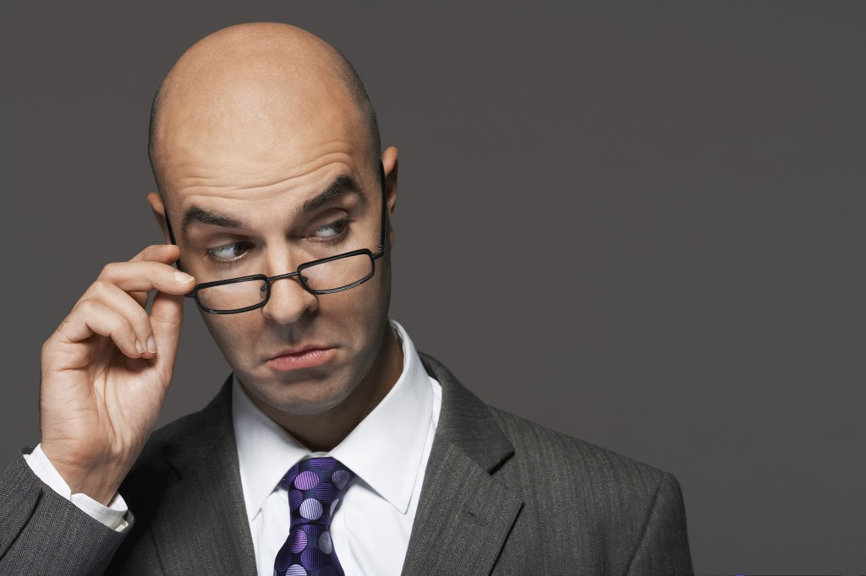
"Do not judge, or you too will be judged" (7:1 NIV).
Notes:
Don't pick on weak areas in others when you are even weaker (7:1).

Slide 22
PEOPLE TELL ME, “JUDGE NOT LEST YE BE JUDGED.” I ALWAYS TELL THEM, “TWIST NOT SCRIPTURE LEST YE BE LIKE SATAN.”
Notes:
What does it mean to judge others (7:1)? How is judging different from discerning?
"A final illustration of Pharisaic practices pertains to judging. The Pharisees were then judging Christ and finding Him to be inadequate. He was not offering the kind of kingdom they anticipated or asking for the kind of righteousness they were exhibiting. So they rejected Him. Jesus therefore warned them against hypocritical judging" (Barbieri, "Matthew," in BKC, 2:33).
Obviously, we all must show discernment. Why?

Slide 23
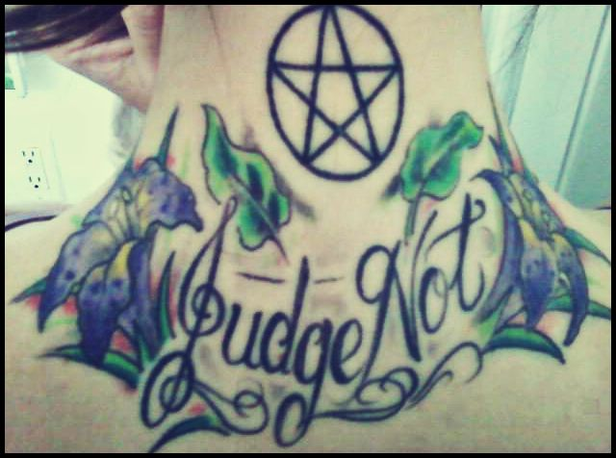
Judge Not Tattoo
Notes:
Some people even tattoo this verse on their bodies, saying, "Judge not!" Why would they do that?

Slide 24
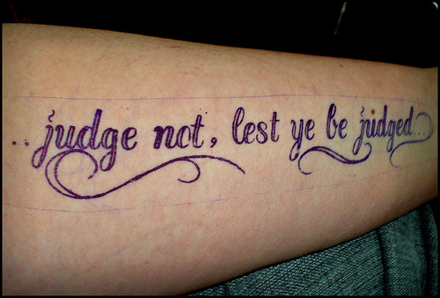
Judge Not Tattoo
Notes:
Maybe as they live out a life of immorality, they don't want anyone to evaluate what they do.

Slide 25
Do not judge.
Notes:
Is it "Do not judge" period?

Slide 26
Do show discernment.
Notes:
No, do show discernment. This will keep us from getting swindled of all our money. We shouldn't say, "That drunk guy with a bottle in his hand says he wants my money to feed the poor. The Bible says I shouldn't judge him, so I'll give him everything!" No, I know better than to give him anything!

Slide 27
DON’T JUDGE
someone’s attitude until you have felt their pain.
Notes:
So what does it mean to judge others?
We all should make judgments, but as the following verses show, we should not make these judgments hypocritically.
We should make judgments. However, "Though judgment is sometimes needed, those making the distinctions (kri÷nw, judge, means 'to distinguish' and thus 'to decide') must first be certain of their own lives" (Barbieri, BKC, 2:33).

Slide 28
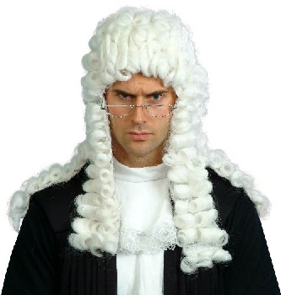
"For in the same way you judge others, you will be judged, and with the measure you use, it will be measured to you" (7:2 NIV).
Notes:
Know that God will hold you to the standard you impose on others (7:2).

Slide 29
What if God judges you as harshly as you judge others?
Notes:
What does it mean to be judged like we judge others (7:2)?
We all have a standard by which we judge people. What is your standard?
Do you tend to see things based on how they're done in your home country?
We also make aesthetic judgments based on what somebody else considers beautiful. (God made us all beautiful, by the way.)
We can compare our boss to the best or the worst boss we've ever had.
And whenever we compare someone to us, we really are only being selective as to what we compare.
My experience has been that I typically contrast one of my strengths with someone else's weakness!
For example, I am pretty organized, so it's easy to judge those who are disorganized—rarely on time, can't find their emails, don't have systems in place, forget stuff, etc.
Yet, I hardly ever compare myself in my weak areas—like forgetting the hurts of others. Someone else judges me about that because that is that person's strength!
But God will use that same standard in our lives and show us each to be hypocrites! He will say, "Rick, you think are organized—but let me judge you in that areas by comparing you to so-and-so who puts you to shame—especially Jesus, who is so organized that he runs the entire universe pretty well!

Slide 30
I. Judge with fear: Realize that God will judge you (7:1-2).
Notes:
The second way to judge others is to…

Slide 31
II. Judge with humility: Judge your own life first (7:3-5).
Notes:
Get your act together before trying to help others get their act together.

Slide 32
"Why do you look at the speck of sawdust in your brother's eye and pay no attention to the plank in your own eye? ⁴How can you say to your brother, 'Let me take the speck out of your eye,' when all the time there is a plank in your own eye? ⁵You hypocrite, first take the plank out of your own eye, and then you will see clearly to remove the speck from your brother's eye" (7:3-5 NIV).
Notes:
Don't pick on weak areas in others when you are even weaker (7:3-4a).

Slide 33
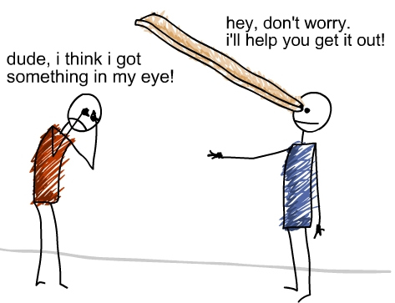
A bit of humor…
Hey, don’t worry. I’ll help you get it out!
Dude, I think I got something in my eye!
Notes:
Jesus was full of humor—appropriate humor. I can imagine everyone laughing here to think of the imagery. The idea is, "Get your act together before you try to help others get their act together!"
If you don't, then you are a hypocrite.
Those who cry "tolerance" are the least tolerant people!

Slide 34
Listen & Learn
Notes:
Solve your issue before helping one who struggles even less in this area (7:4b).

Slide 35
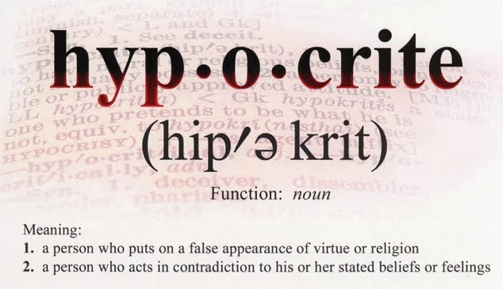
hyp-o-crite
Meaning:
a person who puts on a false appearance of virtue or religion
a person who acts in contradiction to his or her stated beliefs
Notes:
If you fret about another's tiny issue when you struggle with it even more, then you are called a hypocrite.
When you are tempted to judge someone else, think again.
"Don't judge a man until you have walked a mile in his moccasins"—Native American saying

Slide 36
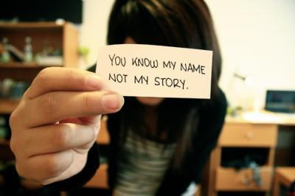
Be careful.
Notes:
Would you actually do any better if you had that person's limitations of family background and the kind of opportunities you have had?
The third way to judge others is to…

Slide 37
III. Judge with wisdom: Discern in whom you should invest your life (7:6).
Notes:
Don't treat everyone equally! Some people aren't worth your time.

Slide 38
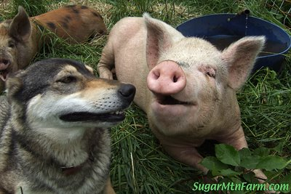
"Do not give dogs what is sacred; do not throw your pearls to pigs. If you do, they may trample them under their feet, and then turn and tear you to pieces" (7:6 NIV).
Notes:
Don't waste valuable resources on those who could care less (7:6a).
Hey! What's Jesus got against dogs? I love dogs! See Philippians 3:2 for insight

Slide 39
"Beware of the dogs" (Philippians 3:2a).

Slide 40
"Beware of the dogs" (2a).

Slide 41
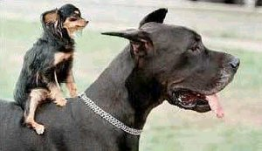
"Beware of the dogs" (2a).

Slide 42
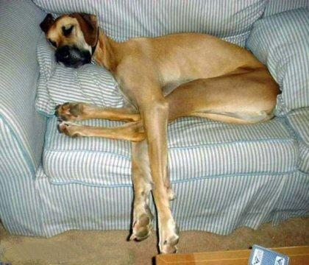
"Beware of the dogs" (2a).

Slide 43
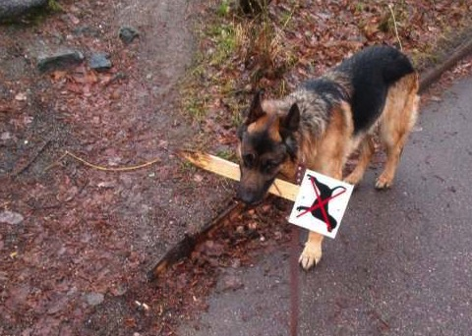
"Beware of the dogs" (2a).

Slide 44
"Beware of the dogs" (2a).

Slide 45
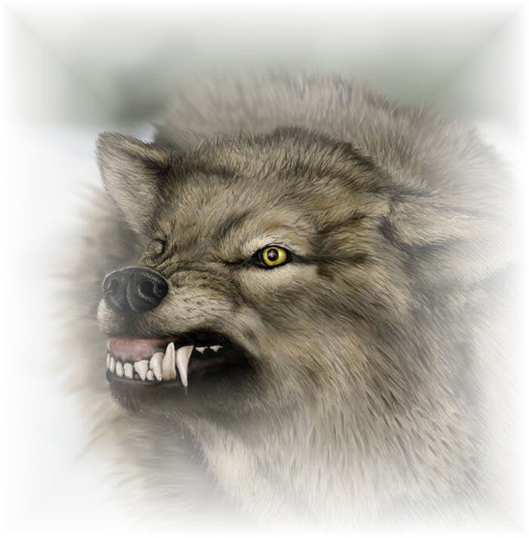
"Beware of the dogs" (2a).

Slide 46
Be Discerning
Notes:
We aren't to judge others when we haven't first judged ourselves, but that doesn't mean that we never make judgments about other people. We all must judge where to spend our time, judge where to invest our money, judge people's character whether to trust them with information, and so on.

Slide 47
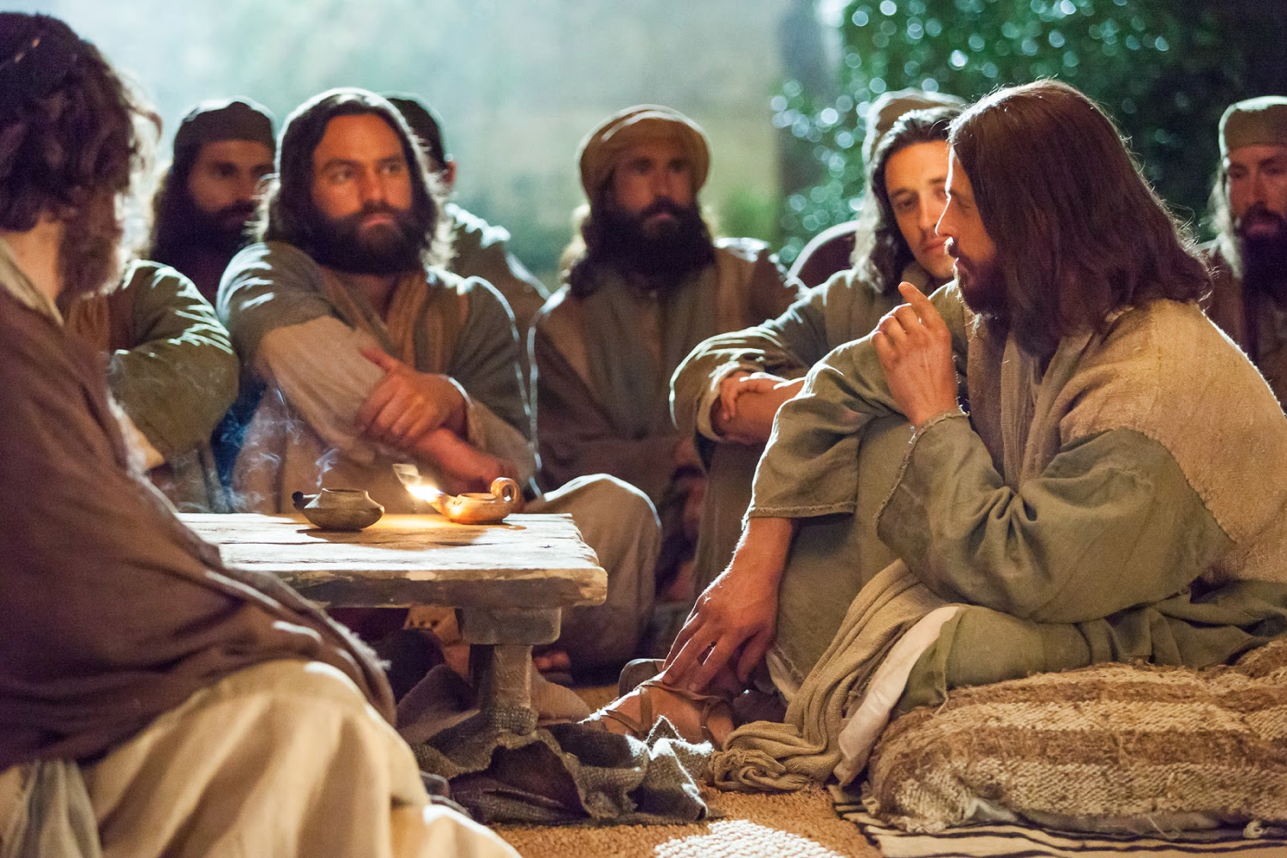
Let me tell you a parable…
Notes:
This is what Jesus did by speaking in parables (Matt. 13). He hid truth from those who refused to believe.

Slide 48
When his disciples asked him why he spoke in parables, Jesus replied, "You are permitted to understand the secrets of the Kingdom of Heaven, but others are not. To those who listen to my teaching, more understanding will be given, and they will have an abundance of knowledge. But for those who are not listening, even what little understanding they have will be taken away from them" (Matthew 13:11-12).

Slide 49
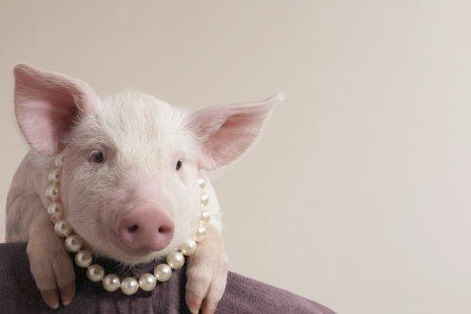
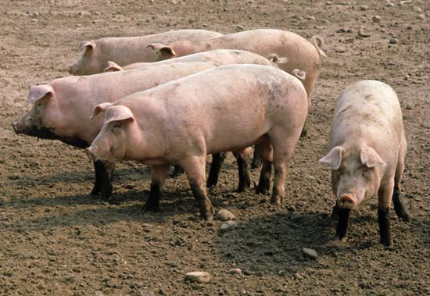
"Do not give dogs what is sacred; do not throw your pearls to pigs. If you do, they may trample them under their feet, and then turn and tear you to pieces" (7:6 NIV).
Notes:
People who scorn you investing in them can actually harm you (7:6b).
If you don't show discernment, your valuable things will be scorned and you will get hurt in the process!
There is a time when we do have to give up. I had to do this in my first pastorate when I committed to stay no matter what. I learned that the people didn't have the same attitude towards me!

Slide 50
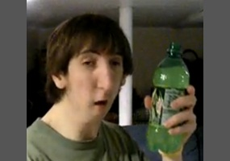
SodaHead
Notes:
I also used to spend time on the website Soda Head to witness to others. After all the disdain the commenters shown for Jesus, I decided it was wasting my time.

Slide 51
How should you judge others?
Notes:
What is the way God says to judge people—if we should do so!

Slide 52
Main Idea
Judge others with fear, humility and wisdom

Slide 53
I. Judge with fear: Realize that God will judge you (7:1-2).
Notes:
Live with the thought that the Lord will hold you accountable.

Slide 54
II. Judge with humility: Judge your own life first (7:3-5).
Notes:
Get your act together before trying to help others get their act together.

Slide 55
III. Judge with wisdom: Discern in whom you should invest your life (7:6).
Notes:
Don't treat everyone equally! Some people aren't worth your time.

Slide 56
Which of these do you need most?
Judge with Fear: Tell God that you know he will judge you.
Judge with Humility: Confess you haven't first judged your own life.
Judge with Wisdom: Ask God who you should start or stop investing your life in.

Slide 57
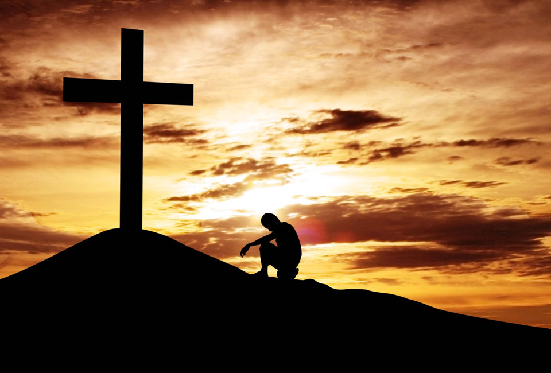
"I trust in your death for me."

Slide 58
Black

Slide 59
NT Sermons link at biblestudydownloads.org
Get this presentation and script for free!

